Slide 1
Java Programming

Slide 2
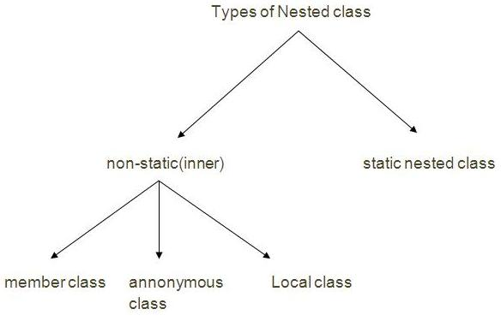
Inner classes
A class declared inside a class is known as nested class.
class outer_class_name{
...
class nested_class_name{
...
}
...
}
Java inner class or nested class is a class i.e. Declared inside the class or interface.
Advantages:
it can access all the members (data members and methods) of outer class including private.
develop more readable and maintainable code
code optimization
Two types of nested classes non-static and static nested classes

Slide 3
Type | Description
Member Inner Class | A class created within class and outside method.
Annonymous Inner Class | A class created for implementing interface or extending class. Its name is decided by the java compiler.
Local Inner Class | A class created within method.
Static Nested Class | A static class created within class.
Nested Interface | An interface created within class or interface.

Slide 4
Java Member inner class
A non-static class that is created inside a class but outside a method is called member inner class.
class TestMemberOuter1{
private int data=30;
class Inner{
void msg(){System.out.println("data is "+data);}
}
public static void main(String args[]){
TestMemberOuter1 obj=new TestMemberOuter1();
TestMemberOuter1.Inner in=obj.new Inner();
in.msg();
}
}
If you want to instantiate inner class, you must have to create the instance of outer class.

Slide 5
Java Anonymous inner class
A class that have no name is known as anonymous inner class in java. It should be used if you have to override method of class or interface. Java Anonymous inner class can be created by two ways:
Class (may be abstract or concrete).
Interface
abstract class Person{
abstract void eat();
}
class TestAnonymousInner{
public static void main(String args[]){
Person p=new Person(){
void eat(){System.out.println("nice fruits");}
};
p.eat();
}
}
A class is created but its name is decided by the compiler which extends the Person class and provides the implementation of the eat() method.
An object of Anonymous class is created that is referred by p reference variable of Person type.

Slide 6
Java Local inner class
A class i.e. created inside a method is called local inner class in java.
public class localInner1{
private int data=30;//instance variable
void display(){
class Local{
void msg(){System.out.println(data);}
}
Local l=new Local();
l.msg();
}
public static void main(String args[]){
localInner1 obj=new localInner1();
obj.display();
}
}

Slide 7
Java Local inner class
A class i.e. created inside a method is called local inner class in java.
public class localInner1{
private int data=30;//instance variable
void display(){
class Local{
void msg(){System.out.println(data);}
}
Local l=new Local();
l.msg();
}
public static void main(String args[]){
localInner1 obj=new localInner1();
obj.display();
}
}
Local inner class cannot be invoked from outside the method.
Local inner class cannot access non-final local variable till JDK 1.7. Since JDK 1.8, it is possible to access the non-final local variable in local inner class.

Slide 8
Java static nested class
A static class i.e. created inside a class is called static nested class in java. It cannot access non-static data members and methods. It can be accessed by outer class name.
It can access static data members of outer class including private.
Static nested class cannot access non-static (instance) data member or method.
class TestOuter1{
static int data=30;
static class Inner{
void msg(){System.out.println("data is "+data);}
}
public static void main(String args[]){
TestOuter1.Inner obj=new TestOuter1.Inner();
obj.msg();
}
}

Slide 9
Java static nested class
There are given some points that should be remembered by the java programmer.
Nested interface must be public if it is declared inside the interface but it can have any access modifier if declared within the class.
Nested interfaces are declared static implicitely.
interface interface_name{
...
interface nested_interface_name{
...
}
}
class class_name{
...
interface nested_interface_name{
...
}
}

Slide 10
Java static nested class
interface Showable{
void show();
interface Message{
void msg();
}
}
class TestNestedInterface1 implements Showable.Message{
public void msg(){System.out.println("Hello nested interface");}
public static void main(String args[]){
Showable.Message message=new TestNestedInterface1();//upcasting here
message.msg();
}
}

Slide 11
ACCESS specifiers
A simple program file can contain more than one class but only one of them should be declared as public.
If more than one class is declared in the same program file, both of them will be considered as different classes.
Access specifiers for classes
Access specifiers for instance variables
four access specifiers- public, private, protected and the default restriction
variable is declared as public, it can be modified from all classes in the same or different packages.
If the variable is private, access is restricted to the class itself
 | public | private | protected | < unspecified >
class | allowed | not allowed | not allowed | allowed
constructor | allowed | allowed | allowed | allowed
variable | allowed | allowed | allowed | allowed
method | allowed | allowed | allowed | allowed

Slide 12
Access specifiers
public class Student { private name; public static void main ( String[] args ) { Student s = new Student (); s.name = "Sai"; // allowed } }
public class StudentTest { public static void main ( String[] args ) { Student s = new Student (); s.name = "Sai"; // not allowed } }
Access specifier for methods is same instance variables
Accessibility of entities are as below:
 | class | subclass | package | outside
private | allowed | not allowed | not allowed | not allowed
protected | allowed | allowed | allowed | not allowed
public | allowed | allowed | allowed | allowed
< unspecified > | allowed | not allowed | allowed | not allowed

Slide 13
Modifiers
There are two types of modifiers in java: access modifier and non-access modifier.
The access modifiers specifies accessibility (scope) of a datamember, method, constructor or class.
There are 4 types of access modifiers:
private
default
protected
Public
Non-access modifiers such as static, abstract, synchronized, native, volatile, transient etc
Private:
The private access modifier is accessible only within class.
If a class contains private data member and private method and try to access these private members from outside the class, which leads to compile time error.
If you make any class constructor private, you cannot create the instance of that class from outside the class.
A class cannot be private or protected except nested class.

Slide 14
Modifiers
Default:
If you don't use any modifier, it is treated as default bydefault.
The default modifier is accessible only within package.
A class is default, it cannot be accessed from outside the package.
Protected
The protected access modifier is accessible within package and outside the package but through inheritance only.
It can be applied on the data member, method and constructor. It can't be applied on the class.
Public
The public access modifier is accessible everywhere. It has the widest scope among all other modifiers.

Slide 15

Modifiers

Slide 16
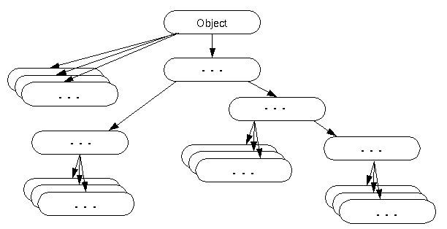
Object class in Java
The Object class is the parent class of all the classes in java by default. In other words, it is the topmost class of java.
The Object class is beneficial if you want to refer any object whose type you don't know.
Notice that parent class reference variable can refer the child class object, know as upcasting.
Object obj=getObject();//we don't what object would be returned from this method

Slide 17
Object class methods
Method | Description
public final ClassgetClass() | returns the Class class object of this object. The Class class can further be used to get the metadata of this class.
public int hashCode() | returns the hashcode number for this object.
public boolean equals(Object obj) | compares the given object to this object.
protected Object clone() throws CloneNotSupportedException | creates and returns the exact copy (clone) of this object.
public String toString() | returns the string representation of this object.
public final void notify() | wakes up single thread, waiting on this object's monitor.
public final void notifyAll() | wakes up all the threads, waiting on this object's monitor.
public final void wait(long timeout)throws InterruptedException | causes the current thread to wait for the specified milliseconds, until another thread notifies (invokes notify() or notifyAll() method).
public final void wait(long timeout,int nanos)throws InterruptedException | causes the current thread to wait for the specified miliseconds and nanoseconds, until another thread notifies (invokes notify() or notifyAll() method).
public final void wait()throws InterruptedException | causes the current thread to wait, until another thread notifies (invokes notify() or notifyAll() method).
protected void finalize()throws Throwable | is invoked by the garbage collector before object is being garbage collected.

Slide 18
Object Cloning in Java
The object cloning is a way to create exact copy of an object.
clone() method of Object class is used to clone an object. The clone() method saves the extra processing task for creating the exact copy of an object. If we perform it by using the new keyword, it will take a lot of processing to be performed that is why we use object cloning.
The java.lang.Cloneable interface must be implemented by the class whose object clone we want to create. If we don't implement Cloneable interface, clone() method generates CloneNotSupportedException.
Syntax for clone() method:
protected Object clone() throws CloneNotSupportedException

Slide 19
Object Cloning in Java
class Student18 implements Cloneable{
int rollno;
String name;
Student18(int rollno,String name){
this.rollno=rollno;
this.name=name;
}
public Object clone() throws CloneNotSupportedException{
return super.clone();
}
public static void main(String args[]){
try{
Student18 s1=new Student18(101,"amit");
Student18 s2=(Student18)s1.clone();
System.out.println(s1.rollno+" "+s1.name);
System.out.println(s2.rollno+" "+s2.name);
}catch(CloneNotSupportedException c){}
}
}

Slide 20
OOPs concepts in JAVA
Encapsulation is a process of wrapping code and data together into a single unit e.g. capsule i.e mixed of several medicines.
Use setter and getter methods to set and get the data in it.
Java Bean is the example of fully encapsulated class.
Advantage of Encapsulation:
By providing only setter or getter method, you can make the class read-only or write-only.
It provides you the control over the data. Suppose you want to set the value of id i.e. greater than 100 only, you can write the logic inside the setter method.
//save as Test.java
package com.cdac.wimc;
class Test{
public static void main(String[] args)
{
Student s=newStudent();
s.setname("vijay");
System.out.println(s.getName());}
}
//save as Student.java
package com.cdac.wimc;
public class Student{
private String name;
public String getName(){return name;}
public void setName(String name){this.name=name}
}

Slide 21
OOPs concepts in java
Consider Student objects are s1 and s2 then
Data binding: s1 and s2 are accessing variable name through a method
Data hiding : s1 is not aware of the value of data being accessed by s1 & viceversa.
Data wrapping: Ex: String is considered as a datatype and that itself is a class . String is serving as both datatype and also as a object.

Slide 22
Java Annotations
Java Annotation is a tag that represents the metadata i.e. attached with class, interface, methods or fields to indicate some additional information which can be used by java compiler and JVM.
Built-In Java Annotations used in java code
@Override - assures that the subclass method is overriding the parent class method
@SuppressWarnings - is used to suppress warnings issued by the compiler
@Deprecated - marks that this method is deprecated so compiler prints warning
Built-In Java Annotations used in other annotations
@Target
@Retention
@Inherited
@Documented

Slide 23
Java Annotations
class Animal{
void eatSomething(){System.out.println("eating something");}
}
class Dog extends Animal{
@Override
void eatsomething(){System.out.println("eating foods");}//should be eatSomething
}
class TestAnnotation1{
public static void main(String args[]){
Animal a=new Dog();
a.eatSomething();
}}

Slide 24
Java Annotations
Java User-defined annotations are easy to create and use.
@interface MyAnnotation{}
There are few points that should be remembered by the programmer.
Method should not have any throws clauses
Method should return one of the following: primitive data types, String, Class, enum or array of these data types.
Method should not have any parameter.
We should attach @ just before interface keyword to define annotation.
It may assign a default value to the method.
There are three types of annotations.
Marker Annotation - An annotation that has no method
Single-Value Annotation - An annotation that has one method
Multi-Value Annotation - An annotation that has more than one method

Slide 25
Java Annotations
Multi-Value Annotation example:
@interface MyAnnotation{
int value1() default 1;
String value2() default "";
String value3() default "xyz";
}
the code to apply the multi-value annotation
@MyAnnotation(value1=10,value2="Arun Kumar",value3="Ghaziabad")

Slide 26
Assertion
Assertion is a statement in java. It can be used to test your assumptions about the program.
While executing assertion, it is believed to be true. If it fails, JVM will throw an error named assertionerror. It is mainly used for testing purpose.
Advantage of assertion:
It provides an effective way to detect and correct programming errors.
class AssertionExample{
public static void main( String args[] ){
Scanner scanner = new Scanner( System.in );
System.out.print("Enter ur age ");
int value = scanner.nextInt();
assert value>=18:" Not valid";
System.out.println("value is "+value);
}
}
Output: Enter ur age 11
Exception in thread "main" java.lang.AssertionError: Not valid
Note: assertion should not be used to check arguments in the public methods because it should result in appropriate runtime exception e.g. IllegalArgumentException, NullPointerException etc.

Slide 27
Static Import
Facilitate the java programmer to access any static member of a class directly. There is no need to qualify it by the class name
Advantage :
Less coding is required if you have access any static member of a class oftenly.
Disadvantage :
If you overuse the static import feature, it makes the program unreadable and unmaintainable.
import static java.lang.System.*;
class StaticImportExample{
public static void main(String args[]){
out.println("Hello");//Now no need of System.out
out.println("Java");
}
}

Slide 28
java doc
We can create document api in java by the help of javadoc tool. In the java file, we must use the documentation comment /**... */ to post information for the class, method, constructor, fields etc.
package com.abc;
/** This class is a user-defined class that contains one methods cube.*/
public class M{
/** The cube method prints cube of the given number */
public static void cube(int n){System.out.println(n*n*n);}
}
On the command prompt, you need to write:
javadoc M.java

Slide 29
Strictfp keyword
The strictfp keyword ensures that you will get the same result on every platform if you perform operations in the floating-point variable. The precision may differ from platform to platform that is why java programming language have provided the strictfp keyword, so that you get same result on every platform.
The strictfp keyword can be applied on methods, classes and interfaces.
strictfp class A{}//strictfp applied on class
strictfp interface M{}//strictfp applied on interface
class A{
strictfp void m(){}//strictfp applied on method
}
The strictfp keyword can not be applied on abstract methods, variables or constructors.

Slide 30
APPLETS
Applet is a special type of program that is embedded in the webpage to generate the dynamic content. It runs inside the browser and works at client side.
Advantage of applet
There are many advantages of applet. They are as follows:
It works at client side so less response time.
Secured
It can be executed by browsers running under many platforms, including linux, windows, mac os etc.
Drawback of applet
Plugin is required at client browser to execute applet.

Slide 31
Differences between applications and applets
Applet | Application
Small Program | Large Program
Used to run a program on client Browser | Can be executed on stand alone computer system
Applet is portable and can be executed by any JAVA supported browser. | Need JDK, JRE, JVM installed on client machine.
Applet applications are executed in a Restricted Environment | Application can access all the resources of the computer
Applets are created by extending the java.applet.Applet | Applications are created by writing public static void main(String[] s) method.
Applet application has 5 methods which will be automatically invoked on occurance of specific event | Application has a single start point which is main method
import java.awt.*; import java.applet.*; public class Myclass extends Applet { public void init() { } public void start() { } public void stop() {} public void destroy() {} public void paint(Graphics g) {} } | public class MyClass { public static void main(String args[]) { } }

Slide 32

Java String
In java, string is basically an object that represents sequence of char values.
An array of characters works same as java string.

Slide 33
The java.Lang.String class implements serializable, comparable and charsequence interfaces.
The java string is immutable i.e. It cannot be changed but a new instance is created.

Slide 34
What is String in java
Generally, string is a sequence of characters.
But in java, string is an object that represents a sequence of characters. String class is used to create string object.

Slide 35
How to create String object?
There are two ways to create string object:
By string literal
By new keyword

Slide 36

String Literal
Java string literal is created by using double quotes

Slide 37
What is String Constant Pool????
String objects are stored in a special memory area known as string constant pool.
Each time you create a string literal, the JVM checks the string constant pool first. If the string already exists in the pool, a reference to the pooled instance is returned. If string doesn't exist in the pool, a new string instance is created and placed in the pool.

Slide 38
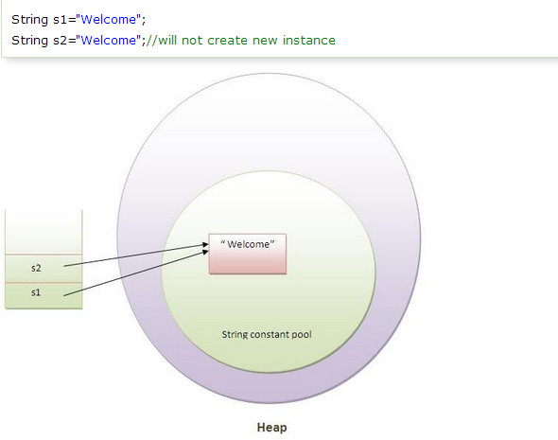
Example

Slide 39
In the above example only one object will be created.
Firstly jvm will not find any string object with the value "welcome" in string constant pool, so it will create a new object.
After that it will find the string with the value "welcome" in the pool, it will not create new object but will return the reference to the same instance.

Slide 40
Why java uses concept of string literal?
To make java more memory efficient (because no new objects are created if it exists already in string constant pool).

Slide 41
By new keyword
String s=new String(“welcome”);
In such case, JVM will create a new string object in normal(non pool) heap memory and the literal "welcome" will be placed in the string constant pool.
The variable s will refer to the object in heap(non pool).

Slide 42
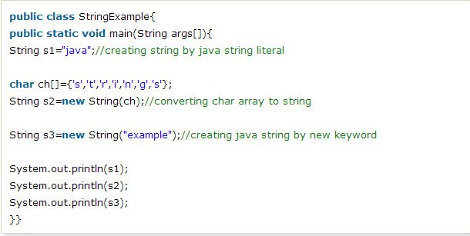

String Example

Slide 43
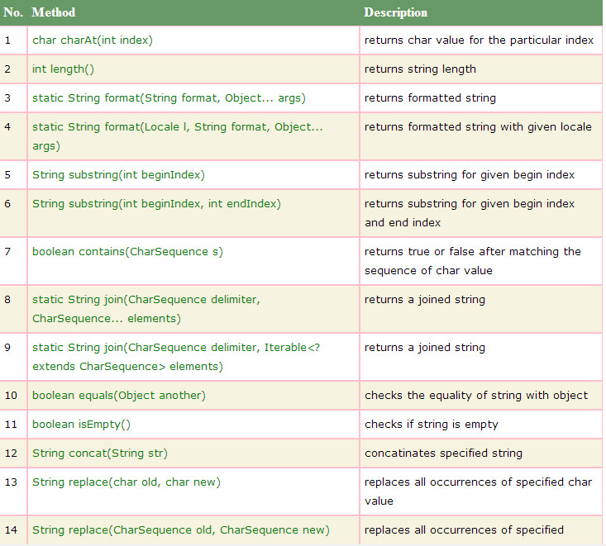

Slide 44
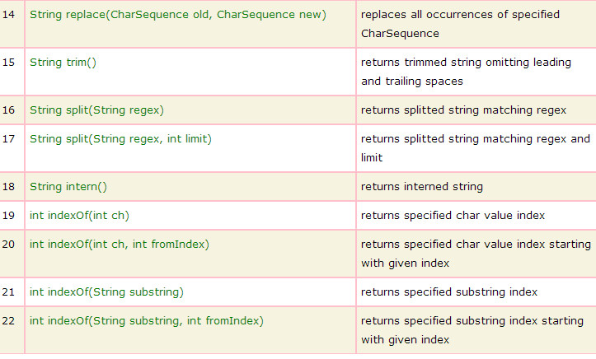

Slide 45
Immutable String in Java
In java, string objects are immutable. Immutable simply means unmodifiable or unchangeable.
Once string object is created its data or state can't be changed but a new string object is created.
Let's try to understand the immutability concept by the example given below:

Slide 46
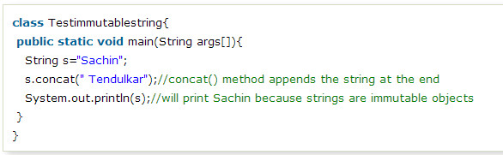


Slide 48
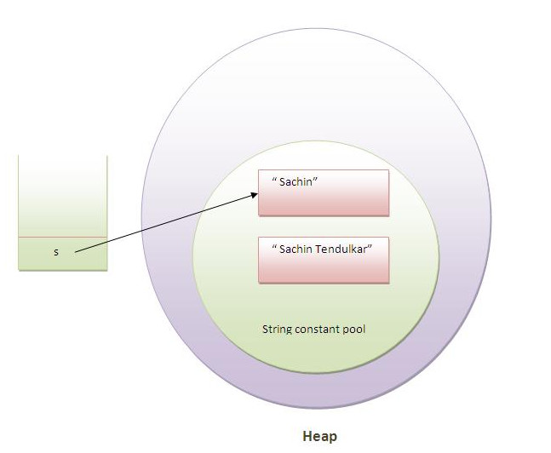
Now it can be understood by the diagram given below.
Here Sachin is not changed but a new object is created with Sachin Tendulkar. That is why string is known as immutable.

Slide 49
As you can see in the above figure that two objects are created but s reference variable still refers to "sachin" not to "sachin tendulkar".
But if we explicitely assign it to the reference variable, it will refer to "sachin tendulkar" object.For example:

Slide 50
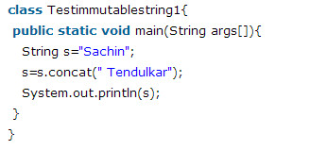


Slide 51
Why string objects are immutable in java?
Because java uses the concept of string literal.
Suppose there are 5 reference variables,all referes to one object "sachin“.
If one reference variable changes the value of the object, it will be affected to all the reference variables. That is why string objects are immutable in java.

Slide 52
String comparison in Java
We can compare two given strings on the basis of content and reference.
It is used in authentication (by equals() method), sorting (by compareto() method), reference matching (by == operator) etc.
There are three ways to compare string objects:
By equals() method
By = = operator
By compareto() method

Slide 53
By equals() method
Equals() method compares the original content of the string.It compares values of string for equality.S
String class provides two methods:
public boolean equals(object another){} compares this string to the specified object.
Public boolean equalsIgnoreCase(String another){} compares this string to another string, ignoring case.

Slide 54
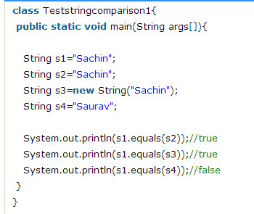
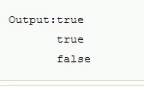

Slide 55
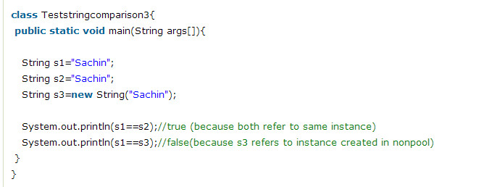
By == operator
The = = operator compares references not values.

Slide 56
By compareTo() method:
C ompareTo() method compares values and returns an int which tells if the values compare less than, equal, or greater than.
Suppose s1 and s2 are two string variables.
If:
S1 == s2 :0
S1 > s2 :positive value
S1 < s2 :negative value

Slide 57
